Slide 1

Spotify 2023 Exploratory Analysis
By: Jonathan Penaloza

Slide 2

Objective
My goal with this project is to understand how “Christmas” music is significant in this dataset, and through the use of this analysis I am able to not only figure out what makes it unique, but what are the common patterns that these present.

Slide 3

Preprocessing
new_data = data.dropna()
print("Old data frame length:", len(data))
print("New data frame length:", len(new_data))
print("Number of rows with at least 1 NA value: ",
(len(data)-len(new_data)))
Otucome:
Old data frame length: 951
New data frame length: 816
Number of rows with at least 1 NA value: 135
data['release_date']=pd.to_datetime(data['release_date’])
ds= data[(data['release_date'].dt.month >=11)]

Slide 4

About my Data
Variable Name | Data Type | Missing Data (%)
track_name | Nominal, object | 0%
artist(s)_name | Nominal, object | 0%
artist_count | Interval, int64 | 0%
released_year | Interval, int64 | 0%
released_month | Interval, int64 | 0%
released_day | Interval, int64 | 0%
in_spotify_playlists | Ordinal, int64 | 0%
in_spotify_charts | Interval, int64 | 0%
streams | Ordinal, object | 0%
in_apple_playlists | Ordinal, int64 | 0%
in_apple_charts | Interval, int64 | 0%
in_deezer_playlists | Ordinal, object | 0%
in_deezer_charts | Interval, int64 | 0%
in_shazam_charts | Ordinal, object | 5.25%
bpm | Ordinal, int64 | 0%
key | Nominal, object | 10%
mode | Nominal, object | 0%
danceability_% | Ratio, int64 | 0%
valence_% | Ratio, int64 | 0%
energy_% | Ratio, int64 | 0%
acousticness_% | Ratio, int64 | 0%
instrumentalness_% | Ratio, int64 | 0%
liveness_% | Ratio, int64 | 0%
speechiness_% | Ratio, int64 | 0%
release_date | datetime64[ns] | 0%
There are 953 entries (rows) in the dataset, with 25 columns. The columns position, name, their datatypes, number of, and percentage of missing values are as follows:

Slide 5
Data Set Summary Statistics
Variable Name | Count | Mean | Standard Deviation | Min | 25th | 50th | 75th |  | Max
in_spotify_playlists | 953 | 5200.125 | 7897.6 | 31 | 875 | 2224 | 5542 |  | 52898
in_spotify_charts | 953 | 12.00 | 19.58 | 0 | 0 | 3 | 16 |  | 147
in_apple_playlists | 953 | 67.81 | 86.44 | 0 | 13 | 34 | 88 |  | 672
in_apple_charts | 953 | 51.90 | 50.63 | 0 | 7 | 38 | 87 |  | 275
in_deezer_charts | 953 | 2.70 | 6.04 | 0 | 0 | 0 | 2 |  | 58
bpm | 953 | 122.54 | 28.06 | 65 | 100 | 121 | 140 |  | 206
danceability_% | 953 | 66.97 | 14.63 | 23 | 57 | 69 | 78 |  | 96
valence_% | 953 | 51.43 | 23.48 | 4 | 32 | 51 | 70 |  | 97
energy_% | 953 | 64.28 | 16.55 | 9 | 53 | 66 | 77 |  | 97
acousticness_% | 953 | 27.06 | 25.99 | 0 | 6 | 18 | 43 |  | 97
instrumentalness_% | 953 | 1.58 | 8.40 | 0 | 0 | 0 | 0 |  | 91
liveness_% | 953 | 18.21 | 13.71 | 3 | 10 | 12 | 24 |  | 97
speechiness_% | 953 | 10.13 | 9.91 | 2 | 4 | 6 | 11 |  | 64
release_date | 153 | 2018-01-06 13:29:24.705882368 | NaN | 1946-11-01 00:00:00 | 2019-12-06 00:00:00 | 2021-12-24 00:00:00 |  | 2022-12-02 00:00:00 |  | 2022-12-30 00:00:00

Slide 6
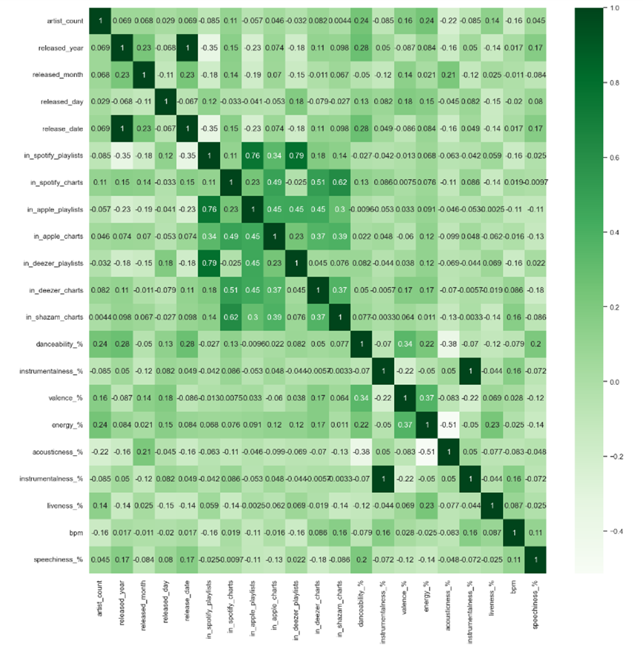
Heatmap
Figure 1: Correlation matrix pf continuous variables excluding categorical variables.
Based on the heatmap both population in Spotify and Deezer seem to have a more similar likings for the same songs than the population of apple users, but all together seem to like the same songs. Ergo there is a higher correlation of Deezer and Spotify users that listen to the same songs than the apple users.

Slide 7
Correlation tables
The following table displays the songs within the dataset that had the highest percentage of energy.
Table 6: Correlation Table/Tables
The following table displays the songs within the dataset that had the lowest percentage of energy.
Track Name | Artist Name | Energy %
I'm Good (Blue) | Bebe Rexha, David Guetta | 97
Murder In My Mind | Kordhell | 97
That That (prod. & feat. SUGA of BTS) | PSY, Suga | 96
Tá OK | dennis, MC Kevin o Chris | 96
Bombonzinho - Ao Vivo | Israel & Rodolffo, Ana Castela | 95
Merry Christmas | Ed Sheeran, Elton John | 94
Every Angel is Terrifying | The Weeknd | 94
Idol (「アイドル」) | YOASOBI | 94
KICK BACK | Kenshi Yonezu | 94
Freaks | Surf Curse | 94
Track Name | Artist Name | Energy %
Happier Than Ever | Billie Eilish | 24
It's Beginning To Look A Lot Like Christmas | Michael Buble | 23
Boyfriends | Harry Styles | 20
Special | SZA | 20
I'm Tired - From "Euphoria" An Original HBO Se... | Labrinth | 20
Something In The Way - Remastered 2021 | Nirvana | 20
Sweet Nothing | Taylor Swift | 16
The Christmas Song (Merry Christmas To You) | Nat King Cole | 15
Heart To Heart | Mac DeMarco | 14
What Was I Made For? [From The Motion Picture Barbie] | Billie Eilish | 9

Slide 8
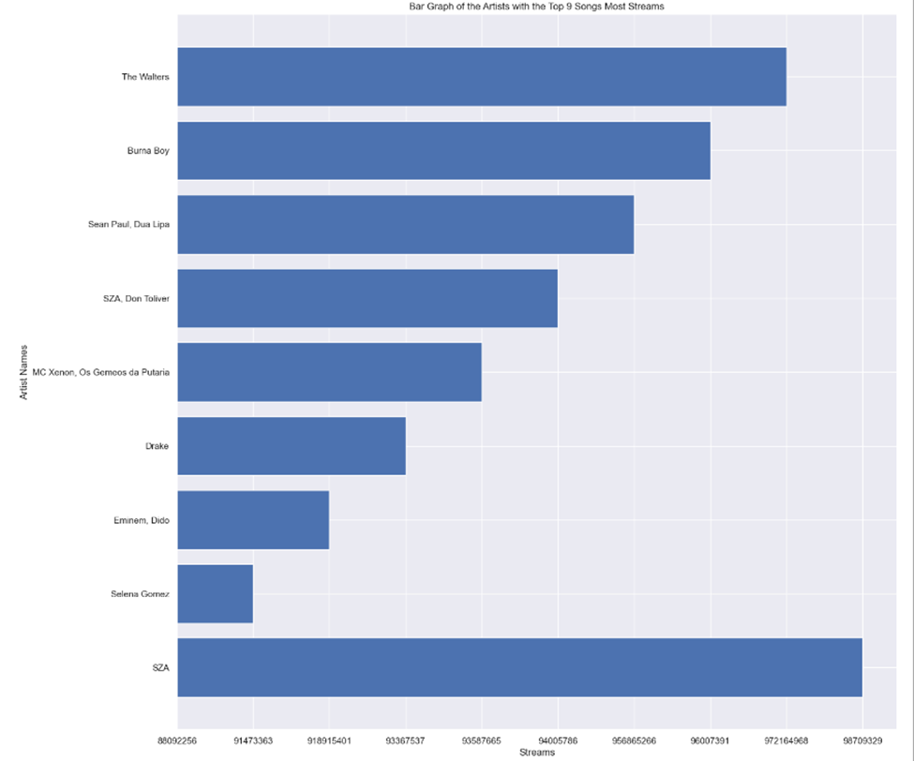
DATA SET GRAPHICAL EXPLORATION
Based on this bar graph, in 2023, The artist with the most streams on Spotify was the SZA with 96709329, while the artist with the second most streams was The Walters with 972164968 streams, and the artists with the third most streams being Burna Boy.

Slide 9
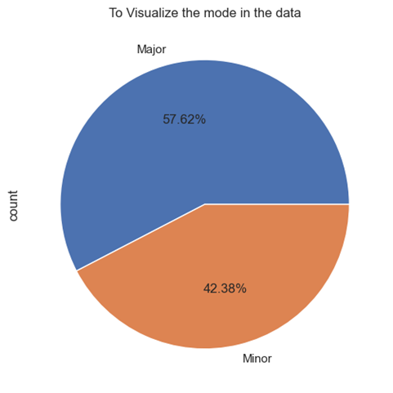
Identify which mode is most used in Christmas songs.

Slide 10
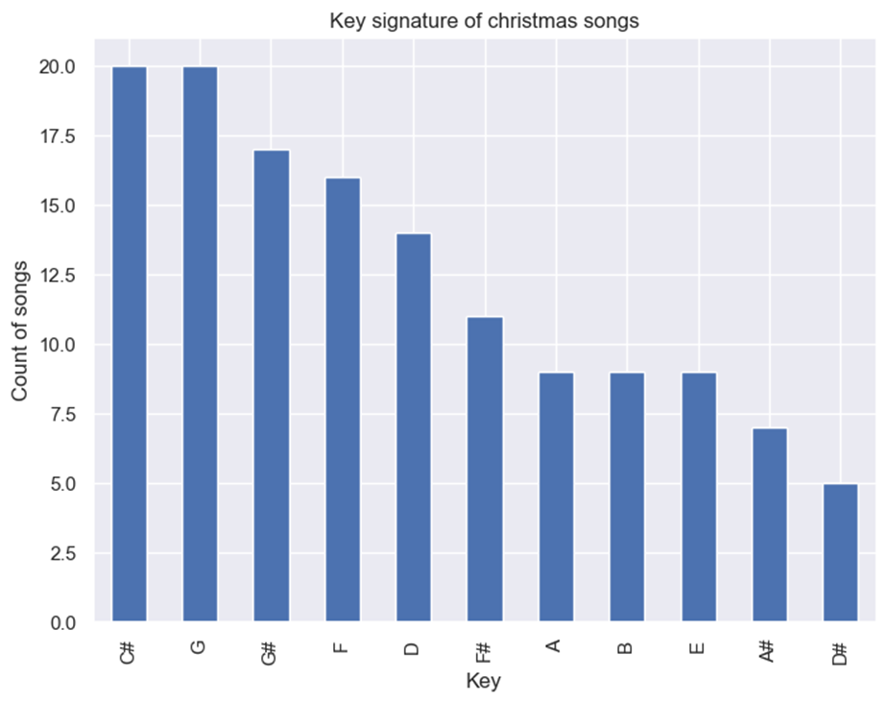
Identify which key most of Christmas songs appear in the data.

Slide 11
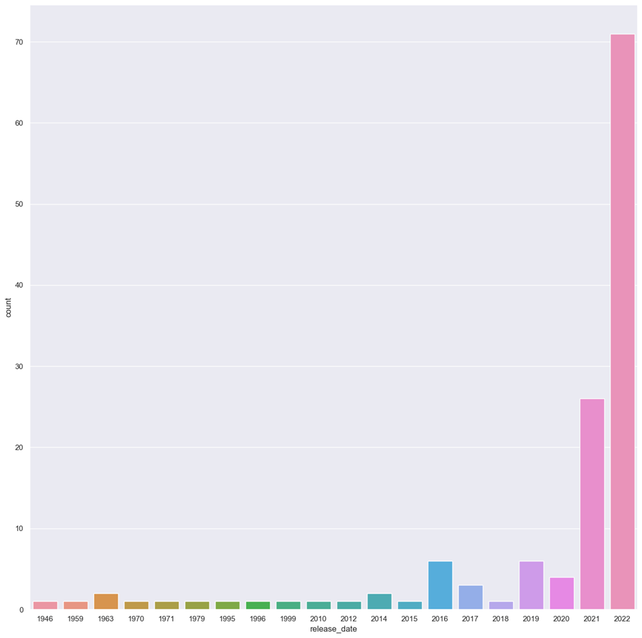
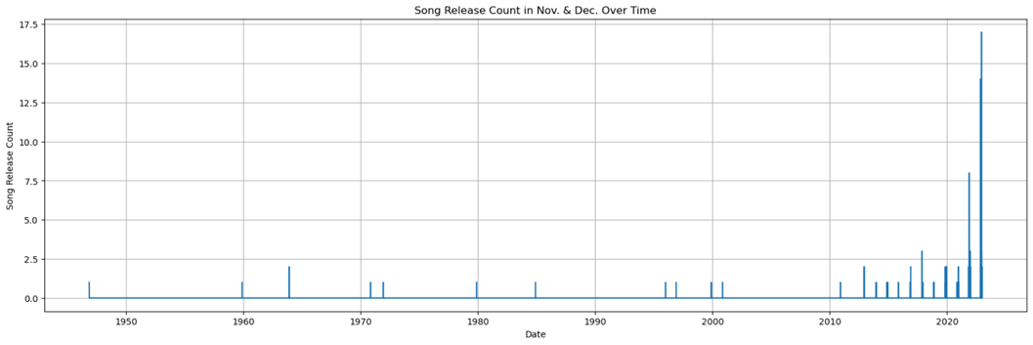
Song Release Count in Nov. & Dec. Over Time

Slide 12
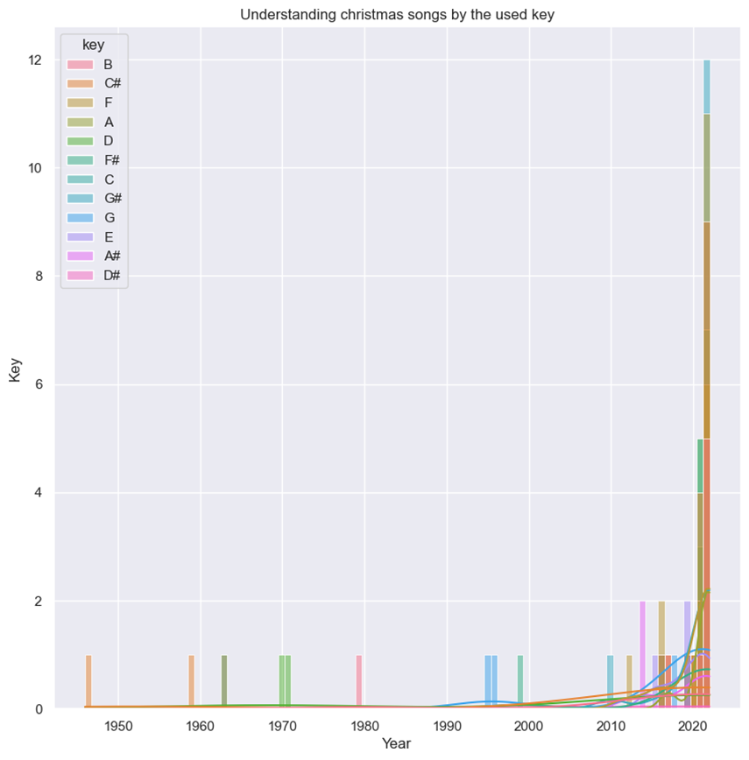
This bar graph helps with understanding Christmas songs by the used keys.
From the Two histograms we observed some interesting things about the diversity of keys and mode of the songs.
Observations:
For the key, there is mode diversity of keys used in the newly released Christmas music.
As predicted G#, C# and G are the most used key signatures.

Slide 13
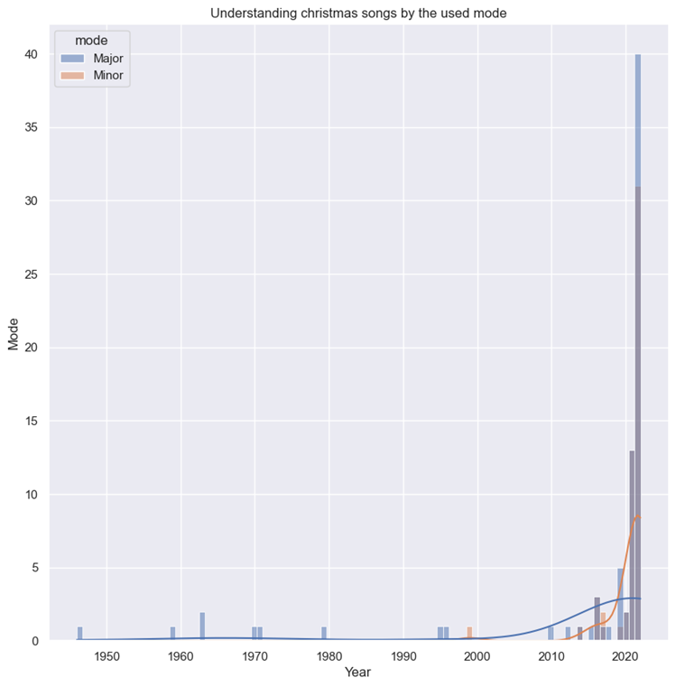
Create histogram to understand Christmas music using mode
Observations:
In the Second chart we visualize that there is a more use of both modes, even after having clear trends of modes over the years.

Slide 14
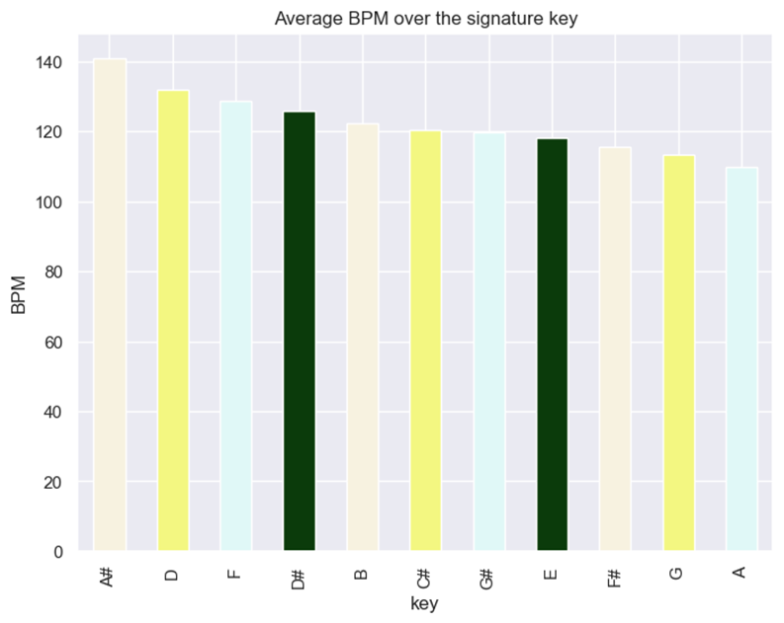
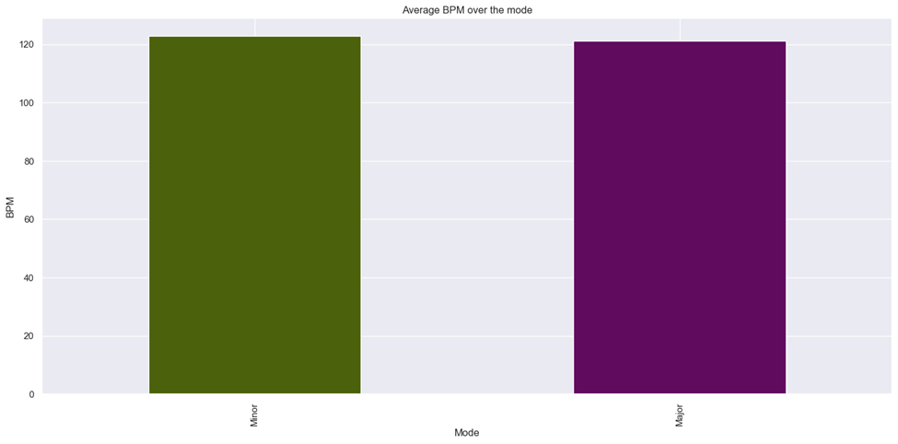
Visualize the bar chart the average BPM over the signature key and modes.
From the first chart we can see that certain songs have a higher speed regardless of how popular those keys might be.

Slide 15
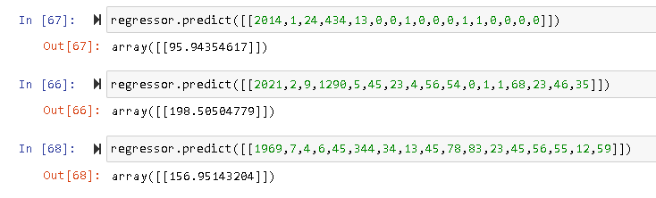
Linear Regression variables and direct outcomes
x=ds[['released_year', 'released_month', 'released_day', 'in_spotify_playlists','in_spotify_charts', 'in_apple_playlists', 'in_apple_charts','in_deezer_playlists', 'in_deezer_charts', 'in_shazam_charts','danceability_%', 'valence_%', 'energy_%','acousticness_%', 'instrumentalness_%', 'liveness_%', 'speechiness_%’]]
y=ds[['bpm’]]
MSE: 812.27
RMSE: 28.50
R-square: -0.24

Slide 16
Challenges and improvements
Working with “group by”
Differentiating the categorical data from the statistical data
The implementation of the new column of Date/Time and how it affected the outcomes of the process.
data = pd.read_csv('spotify_2023.csv', encoding = 'ISO-8859-1', engine= 'python', parse_dates=['release_date’]) (different encoding)
Time management
Need better preparation
More visuals
Look up to more possibilities for linear regression.

Slide 17
Findings
The year 2022 saw the most Christmas songs created, driven by technological advancements and the globalization of music.
Artists and musicians explored new sounds and innovative production techniques, resulting in a surge in Christmas songs.
Key signatures and modes have diversified, with artists drawing inspiration from different cultures and genres.
Tempo in Christmas music is not arbitrary, as certain keys may have inherent associations with the holiday season.
Spotify, Apple Charts, Shazam, and Deezer share similarities in heat maps and statistics, but each platform has its unique features and user base.
Understanding these differences can provide a deeper understanding of music consumption across different streaming services.

